Slide 1
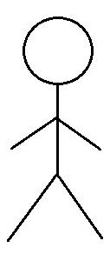
Use Case Diagram
Trox Application
Use Case Diagram
Module: 01. User's Account
01.01 Account authentication/ authorisation
01.02 Account Summary
01.03 Customer Support
User
Account Manager
Customer Support

Slide 2
Use Case Diagram
Trox Application
Use Case Diagram
Module: 02. 01 Buy/Sell products
02.01 Browse for product
02.02 Make Payment
Customer Support
02.03 Upload Products
User
02.04 Submit rating
02.05 Post Review

